Slide 1
For state institutions and local governments
How to introduce a payment module using VISS infrastructure?
Notes:
The aim of this material ir to provide a short introduction in the possibilities of the payment module available to state institutions and local governments through the VISS infrastructure.

Slide 2
Contents
Introduction
What is the payment module and what are it's possibilities?
What is the functionality of a payment module?
The main steps of payment module
How to introduce payment module step by step?
How to introduce payment using a card?
Frequently asked questions
Useful information sources
Contact information
Notes:
Take look at the contents. The information included in this material is split into three categories:
Introduction – a general look at the elements of e-government;
Opportunities for institutions – practical information on the solutions offered by SRDA and their benefits;
Information – additional sources and contact information.

Slide 3
What is the payment module and what are it's benefits?
Notes:
Before moving on to practical steps of introducing the system, let us take a look at what is the payment module and what are it’s benefits.

Slide 4
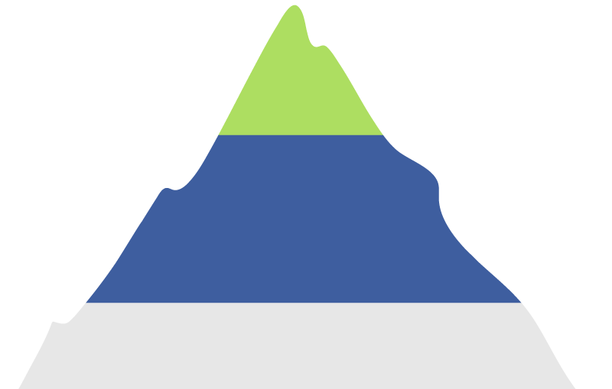
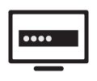
Payment module - a part of SISI infrastructure
Public environment
E-services
Public Service Directory
Working environment
Single login module
Payment module
State Information System Integrator
Commercial banks
State registers and state information systems
Notes:
The information sharing platform is comprised of several parts:
The public environment is formed by the well-known state and local government service portal Latvija.lv, which hosts e-services and the public service directory;
State registers and state information systems that are used for data exchange solutions and e-services;
State directories and State information system, that are useful when creating data exchange solutions and e-services.

Slide 5
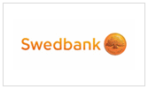
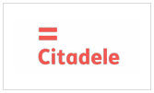
Payment module features
Payment module
support services payment process
Payment possibilities
Internet banking
Payment cards
Usage possibilities
On other portals
of institutions
E-services
Public services
Notes:
A completely integrable tool is available for institutions – it guarantees safe connection to banking information systems and provides a useful; way of aquiring payment status.

Slide 6
Payment methods available
Using an internet banking
Using payment cards
Allows for payment of 8 banks
Payments with VISA and MasterCard are accepted
The possibility to make payments in all the world and it is not attracted to Latvian credit institutions
Notes:
No notes.

Slide 7
Advantages of the payment module
No need for a separate payment system
Ensured cooperation with banks
Secure link to banking systems
Convenient payments on Latvija.lv or other portals
Client
Institution
Information on payment status
Notes:
No notes.

Slide 8
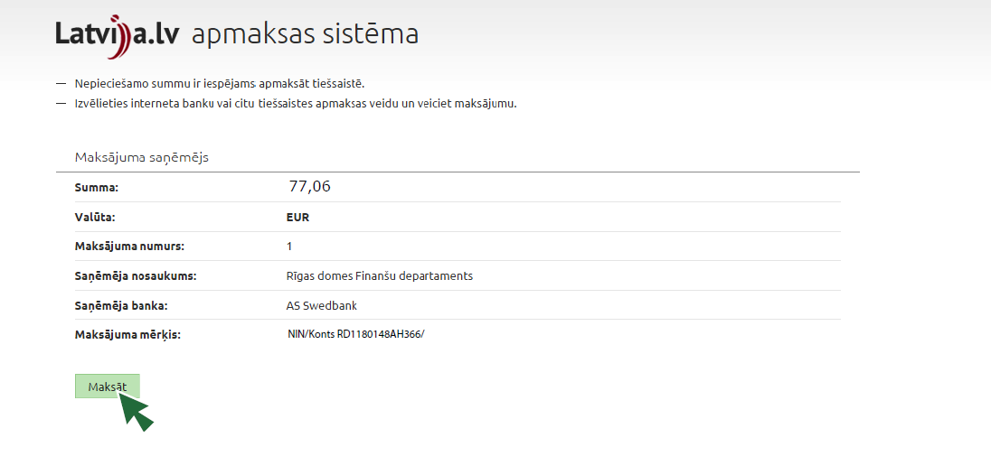
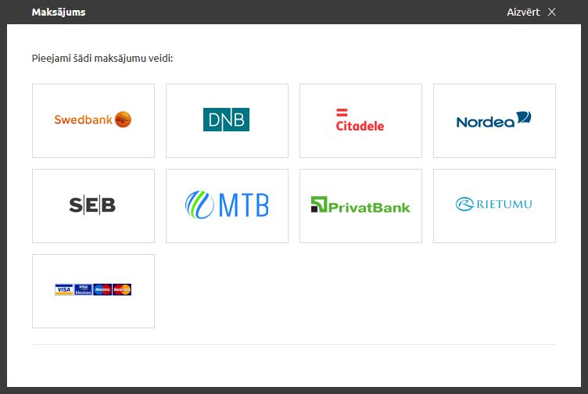
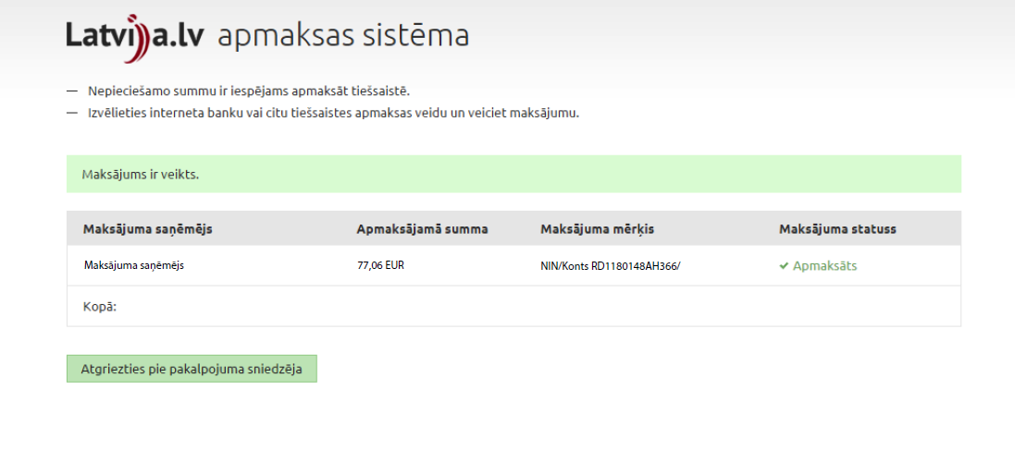
Example of the payment module
8
Notes:
Example of the payment module

Slide 9
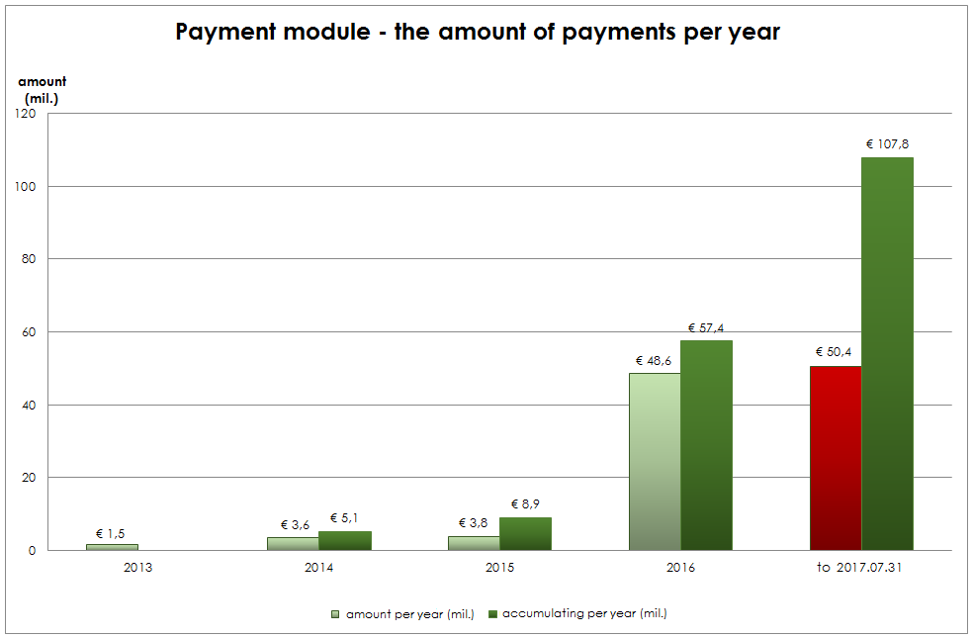
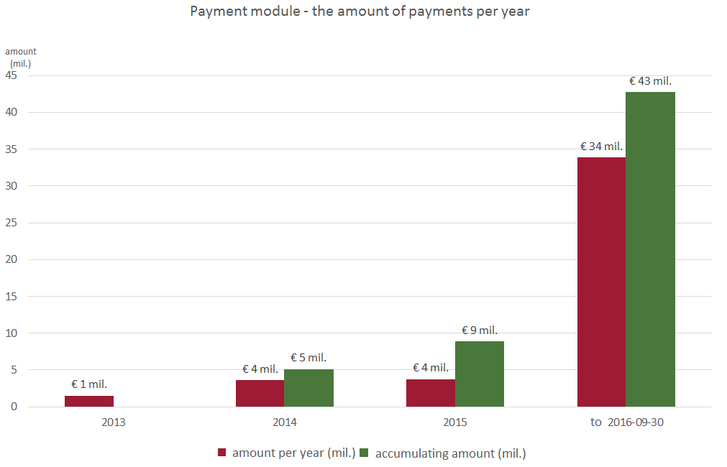
The yearly increase of the amount of Payment module
Amount more than 54 mil.euro in 2017 (more than 4 mil.euro compared to 2016)
Notes:
The slide contains the payments amount statistics over the years. Statistics contains the amount of each year from 2013, and the accumulative amount of up to 31.07.2017.

Slide 10
The payment module is used on 15 portals
Construction IS of the Ministry of Economics, bis.gov.lv
Latvian National Library Digital Library portal, digi.lndb.lv
E-service system of the Ministry of Agriculture, eps.zm.gov.lv
E-service portal of the Patent Office, eservices.lrpv.gov.lv
Geolatvija.lv portal, geolatvija.lv
Electronic auction portal (Court Administration), izsoles.ta.gov.lv
Portal of the National Archives, arhivi.gov.lv
SLS portal kadastrs.lv
Portal krajobligacijas.lv
Portal Latvija.lv
Joint catalogue of national museum collection, nmkk.lv
Business register portal, ur.gov.lv
Portal of the State Unified Computerised Land Register, zemesgramata.lv
14. Jurmala City Council service portal, epakalpojumi.jurmala.lv
15. SRS Electronic declaration system, eds.vid.gov.lv
Notes:
The payment module is already available on 15 portals.

Slide 11
What is the functionality of a payment module?
Notes:
No notes.

Slide 12
Action of the payment module
Institution
SRDA payment module
Bank
Payment initiated
Payment system window
Internet banking
Pay
Choice options:
Internet banking
Payment card
Repeated
authentication
E-service
user
1) for institution
2) for a user
Ensures a status
1) Finished
2) Processing
3) Cancelled
Status
Finish action
+Payment section «My workplace»
Notes:
Overall description of the payment module process.

Slide 13
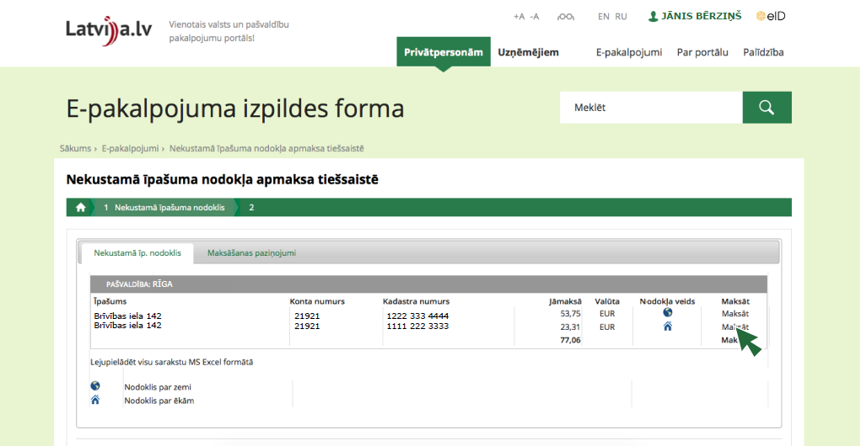
Example of internet banking payment
Notes:
No notes.

Slide 14
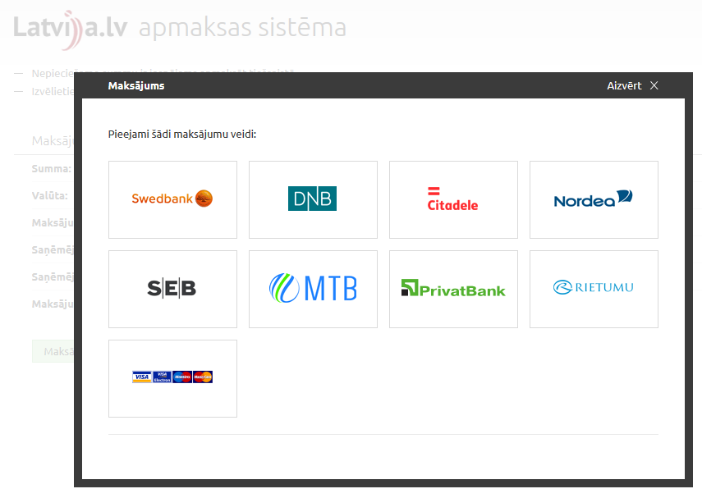
Example of internet banking payment
Notes:
No notes.

Slide 15
Example of internet banking payment
Notes:
No notes.

Slide 16
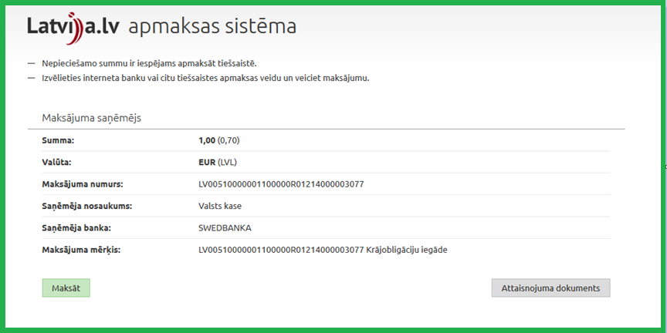
Payment card example
Notes:
No notes.

Slide 17
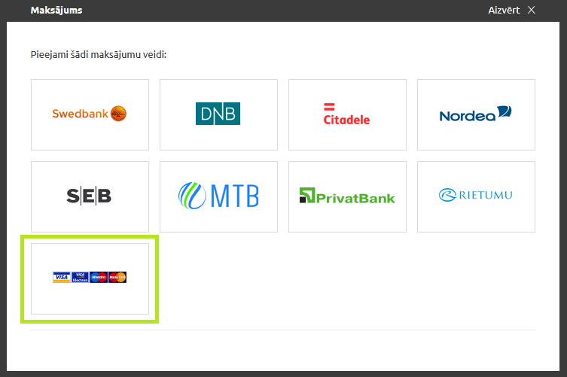
Payment card example
To perform a payment using a card choose the last menu
Notes:
No notes.

Slide 18
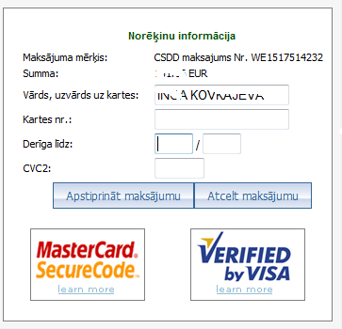
Payment card example
Input card data and perform a payment:
Notes:
No notes.

Slide 19
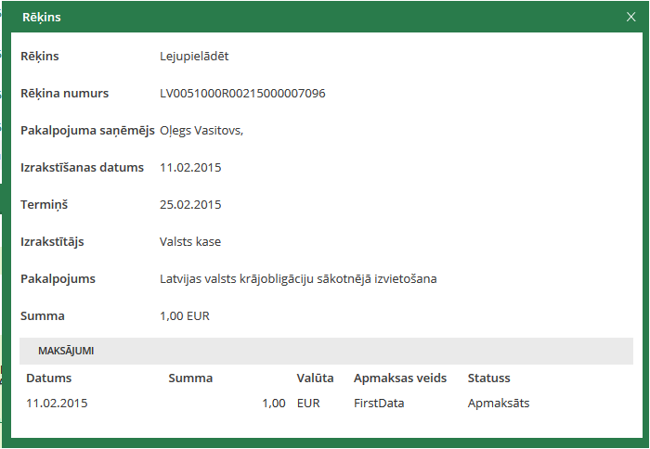
Card payments and
client workplace
Notes:
No notes.

Slide 20
How to introduce payment module step by step?
Notes:
In the introduction we discussed the benefits of the module and its components. Now let us turn to practical steps that the institutions and SRDA have to take in order to implement the payment module.

Slide 21
How an introduction of payment module works:
7.
Maintenance
6.
Introduction into products
5.
Signing an acceptance deed
4.
Accept testing
3.
Development*
2.
Public service catalogue card making
1.
Initiation of cooperation
SRDA liability
Institution liability
*
This step can be omitted
Notes:
An average introduction duration is four months, of course, each case is individual. Processes, for example, a conclusion of an agreement can be performed paralelly to other steps.

Slide 22
1. Initiation of cooperation
Responsible person:
Institution
To be performed:
Institution addresses SRDA using an e-mail motivating the usage aim and necessity
If SRDA accepts* provision of the service, an institution sends a filled in cooperation event registration blank (institution also chooses, which identification providers are necessary)
Banks reply to SRDA or accept the cooperation with the institution
SRDA registers the cooperation and begins together with an institution to create connections
*A module can be used by state institutions and municipalities that provide public service, SRDA evaluated for example the provision for corporations
Notes:
Please take a look at the developer documentation at the publicly available part of the VISS portal (viss.gov.lv): «Information» -> «Documentation» -> «Payment module». Link to resources:
https://viss.gov.lv/lv/Informacijai/Dokumentacija/Koplietosanas_komponentes/Maksajumu_modulis.
Before starting cooperation, we invite you to have a look at payment module implementation procedure «Pieteikšanās Latvija.lv apmaksas sistēmai»:https://viss.gov.lv/lv/Informacijai/Partneriem/Sadarbibas_proceduras/kopeja_shema_MM

Slide 23
Connection establishment
Introduction into products
Development
Testing
An institution sends:
IP addresses from which the Payment module will be initiated
Both parties have to exchange the certificates
Person’s contacts (name, surname, phone number, e-mail)
Account numbers to which the payments are going to be transferred:
IBAN number, receiving bank, account owner (institution), institution registration number (necessary if Nordea bank had conceptually accepted because accounts shall be registered in this bank)
SRDA coordinates connection establishment and informs the institution about:
SRDA Payment module service test environment address
SRDA party certificates which a client has to import on their side of the servers
Notes:
Establishing a connection to the developer environment is not obligatory because the institution can organise the development without a developer environment.

Slide 24
2. Service card creation
Responsible person:
Institution
To be performed:
In order to receive user's rights to create a public service card (PSC), a filled in blank must be sent to SRDA via mail or to pakalpojumi@vraa.gov.lv including an e-signature
Until the testing the PSC with a payment template and a price-list shall be created, because in the request the public catalogue generated identifiers will have to be stated which identify the service and payment position
PSC are supposed to be created twice:
For testing environment
For production environment
A template of an application for obtaining the rights of a public service user
Notes:
More information on the Public Service Directory: http://www.vraa.gov.lv/lv/katalogs/

Slide 25
3. Development*
Responsible person:
Institution
To be performed:
An institution organizes the process of development in accordance with the integration instruction of SRDA
SRDA provides consultative support
Integration instruction (Payment module and Resident payment provision)
*This step can be omitted
Notes:
A developer environment is not an obligatory requirement because the development process can be organised without it.

Slide 26
4. Accept testing
Responsible person:
Institution
To be performed:
If an institution has successfully initiated Payment module, made a payment and received payment status, SRDA is informed indicating:
successful payment time (date and time)
to perform a payment for service step title and unique number for which it is asked to be performed
payment for the payment title within which the payment has been performed
SRDA VISS test environment perform the verification - if during the indicated time by the institution there have been payment attempts and at least one has been processed, an institution can prepare an acceptance test act
Notes:
No notes.

Slide 27
5. Signing an acceptance deed
Responsible person:
Institution
To be performed:
An institution prepares acceptance testing act
SRDA complements, coordinates an act and after it's signing invites the institution to send information for connection establishment in the production environment
Act for E-service «Unifide payment module» integration
Notes:
SRDA records the performed testing in audit notes and the institution prepares an acceptance testing act including supplementary information regarding the website.
SRDA supplements and coordinates an act and after it's signing invites the institution to send information for connection establishment in the production environment.

Slide 28
6. Introduction into products
Responsible person:
SRDA and an institution
To be performed:
Connection establishment term is defined by the concluded agreement between SRDA and institution
Notes:
If testing is completed successfully then signing the acceptance testing act from both parties SRDA sends information for establishing a connection for operational needs.
Connection establishment term is defined by the concluded agreement between SRDA and institution.
The institution informs SRDA if the payment module has been called successfully and if it was possible to make a payment and receive a status regarding the completion of payment.

Slide 29
7. Maintenance
Responsible person:
Institution
To be performed:
An institution is responsible for the introduced solution action control
SRDA can if necessary provide consultative support
Notes:
Work is not complete on the day the module has been introduced, the institution has to plan its maintenance and development.

Slide 30
How to introduce payment using a card?
Notes:
The introduction of the card payment system is slightly different from the introduction of internet banking payment system.

Slide 31
How an introduction of payment card payments works:
5.
Introduction into products
4.
Testing
3.
Development
2.
Co-operation agreement
1.
Initiation of cooperation
SRDA liability
Institution liability
Notes:
The card payment system introduction differs because it involves the Treasury.

Slide 32
Preconditions for implementing credit card payment functionality
On external portals
Connected payment module
Defined PSD service card
In Latvija.lv
e-services
Paid service in Latvija.lv test or production environment
Defined PSD service card in test or production environment
Latvija.lv PSD
Defined PSD service card in test or production environment
Notes:
No notes.

Slide 33
1. Initiation of cooperation
Responsible person:
Institution
To be performed:
Institution sends a request, SRDA hands over for review to State Treasury - of accepted determines the type of agreement - bilateral or tripartite
Notes:
No notes.

Slide 34
2. Co-operation agreement
Responsible person:
SRDA and an institution
To be performed:
Before e-service introduction of the unified authentication it is necessary to conclude a cooperation agreement between the institution* and SRDA using the typical interagency agreement form provided by SRDA
*In accordance with State Administration Structure Law interagency agreement institution has to be agreed upon with it's superior institution (ministry), that is why this process intends more time
Notes:
No notes.

Slide 35
3. Development
Responsible person:
Institution
To be performed:
Institution creates card payment request in PSD test environment, which is reviewed by SRDA, modeling State Treasury activities
In case of approval a card payment feature is included in the payment window
Notes:
No notes.

Slide 36
4. Testing
Responsible person:
Institution
To be performed:
If testing performed by institution is successful then without acceptance act it can be introduced in production
Notes:
No notes.

Slide 37
5. Introduction into products
Responsible person:
SRDA and an institution
To be performed:
Institution creates card payment request in PSD test environment, which is reviewed by State Treasury
In case of approval a card payment feature is included in the payment window
Notes:
No notes.

Slide 38
The most common problems
!
Public service card is not created
In order to ensure payment module operation, PSD with payment template and price list have to be prepared, payment data is validated with PSD data.
!
Public service card is not precisely defined
PSD payment template with previously identified price list positions has to be defined for payment module operation. Payment template and price list have to be activated.
!
Payment request is not precisely defined
Data from PSD payment section have to be indicated in the payment module request - generated identifiers that identify the service and payment position.
Notes:
No notes.

Slide 39
The most common problems
!
Card payment request restriction
Card payment request can be created for a PSD service step taking into the following restrictions:
Services step name can contain on to 42 symbols;
The prohibited symbols in the service step name are ! @ # $ % ^ & * ? ~ ; “ , . () = “enter” “tab”;
Service step can contain not more than 1 (one) State treasure`s account and 1 (one) payment list position.
!
Bank restrictions for payment description definition
Payment purpose definition is limited to 70 signs.
Notes:
No notes.

Slide 40
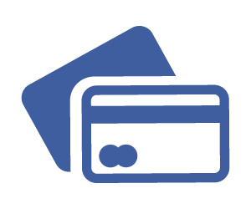
Frequently asked questions
Which payment method to use when testing a payment with DemoBank?
Third radio button “Browser (E)+Server2Server after 15 sec (E)” shall be chosen.
How quickly can a bank status be obtained?
Status reception for banks can differ, on average - starting from a couple of seconds to several minutes.
Why does wrong price list error notification appear, if the number of price list position matches with the one identified in the request?
By identifying a number of position in the payment request price list it has to be written without a zero in front.
Notes:
No notes.

Slide 41
Find out more:
State information system integrator www.viss.gov.lv
Shared services directory
Payment module documentation
Payment module implementation procedure
Notes:
More information is available on these websites…

Slide 42
Contact information
For communication with the specialists of the Information System Development Department: e-mail: epak@vraa.gov.lv
Notes:
...if you want to cooperate or have further questions, please contact the SRDA specialists of the Information System Development Department by using the indicated contact information.

Slide 43
For state institutions and local governments
How to introduce a payment module using VISS infrastructure?
Notes:
Thank you! Any questions?

Slide 44
Portal Latvija.lvservice
synchronous payment process
Request service
PM web service
PM user's interface
service
IVISRequest
(StartPaymentSync)
IVISRequest
(StartPaymentSync)
IVISResponse (URL)
IVISResponse (URL)
Data regarding payments
Redirect (URL)
Response (URL)
Banks
Stauts in PM interface
IVISRequest
IVISRequest
Stauts in PM

Slide 45
Portal Latvija.lvservice
asynchronous payment process
Integration
service
PM web service
KDV
PM user's interface
service
IVISRequest
(StartPayment)
IVISRequest
(StartPayment)
Wants to pay
ResponseURL
IVISResponse
IVISResponse

Slide 46
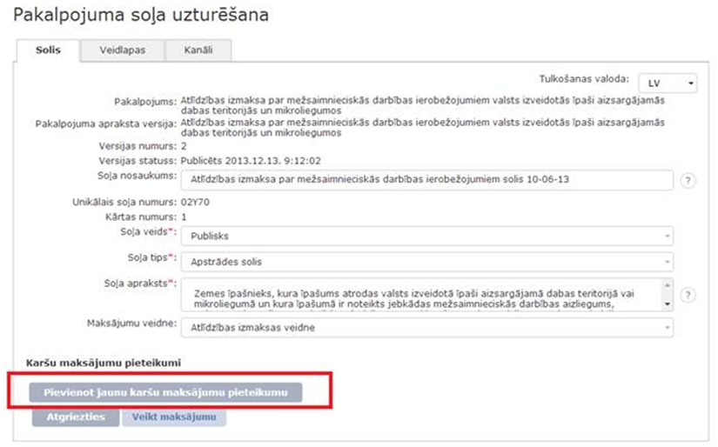
Application for card payments
SRDA registers agreement on VISS
Institution adds new card payment request to the service step:

Slide 47
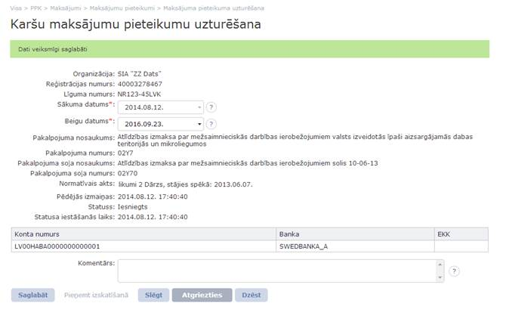
Application for card payments
Institution fills in the application and submits it for revision to State Treasury:

Slide 48
Example of internet banking payment

Slide 49
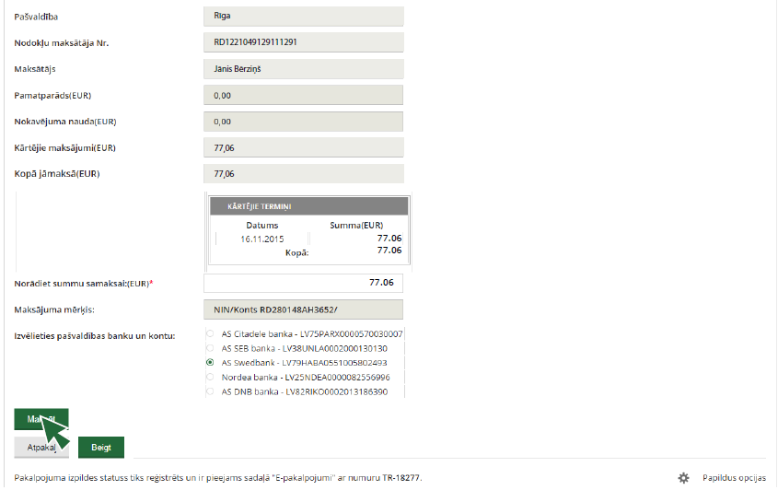
Example of internet banking payment

Slide 50
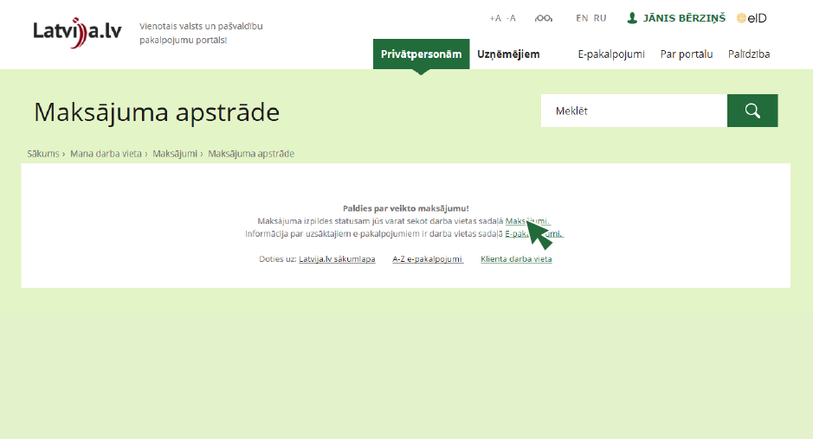
Example of internet banking payment

Slide 51
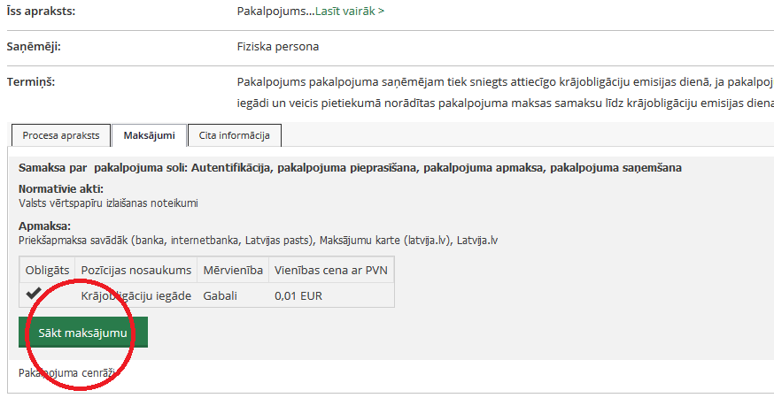
Payment card example

Slide 52
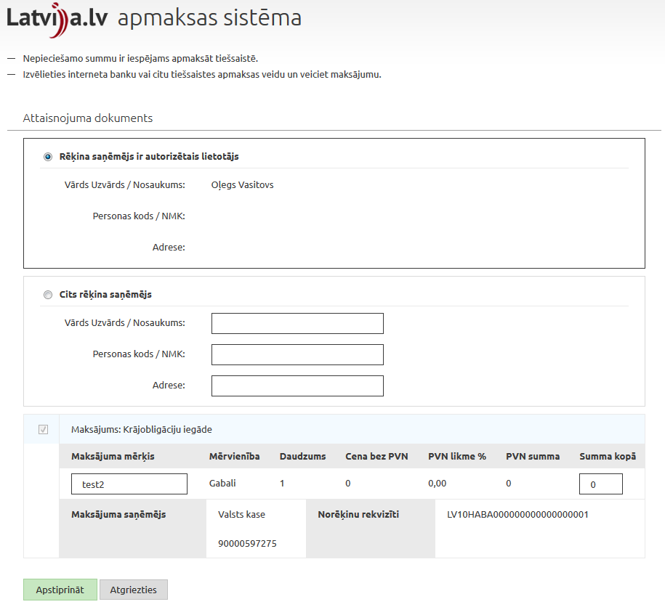
Payment card example

