Slide 1
State Regional Development Agency services for state and local government institutions
What is State Information System Integrator?
Notes:
Aim of the informative material "What is State Information System Integrator?" is to provide the employees of state and local government institutions with a general overview of the possibilities of State Information System Integrator.

Slide 2
Contents
Introduction
What is VISS?
Possibilities for institutions
Data exchange environment
Data distribution network
Document integration environment
Public Service Directory
E-services environment for hosting and operating services
Single login module
Payment module
Geospatial data integrator
Useful information sources
Contact information
Notes:
Take a look at the contents of the presentation. As you can see, the information is divided into three categories:
Introduction – overall introduction of VISS;
Possibilities for institutions – practical information on offered services;
Information – external information sources and contacts.

Slide 3
What is VISS?
Notes:
Before we move on to particular services, let us take a look at what VISS or State Information System Integrator is.

Slide 4
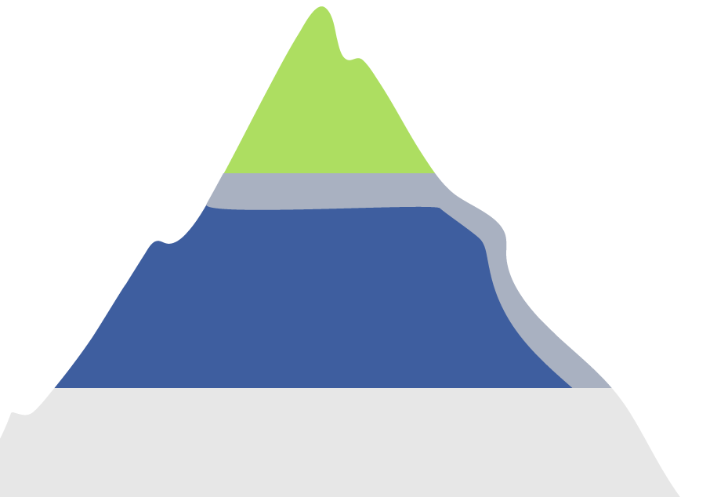
What is VISS?
It is a package of solutions that ensures the following capabilities to State Institutions:
Capability to exchange with information over various systems in a standardised way
The infrastructure support necessary for functioning of the E-services as well as access to various common use components for the development of e-services, for example:
Public environment
E-services
Public Service Directory
Environment of accommodation and operation of e-services
Viss.gov.lv
Data exchange environment
Working environment
Data distribution network
Single login module
Document integration environment
Payment module
E-service
environment
Catalogues
Modules
Guidelines
Geospatial data integrator
State registers and state information systems
Population
Register
Register of Enterprises
SSIA
registers
Other
registers
Notes:
The platform of common use of e-services consists of several parts:
the publicly visible and known part is the portal of state and local government services Latvija.lv, which includes e-services and the Public Service Directory;
the State Information System Integrator is the working environment, where useful information and different templates, including single login and payment modules, are available in a single place;
as well as all state registers and state information systems that are useful in creating data exchange solutions and e-services.

Slide 5
What is the VISS portal?
The portal www.viss.gov.lv ensures access to VISS and Latvija.lv infrastructure resources, which ensures the fulfilment of the e-service usage and development tasks. The portal also ensures access to the Public Service Directory. It is planned to add the functionality of publishing e-forms and develop an environment for submitting them to institutions.
Documentation section for publishing guidelines and standards that govern the development and use of e-service and VISS shared components.
In the workplace of an employee, it is possible to administer and process all the information received within e-service (including the submitters of e-forms after 2016), for example, with residents if the service provider is not able to integrate their inner document management system using the Document Integration Environment.
In the e-application to an official state authority section, there are documents available that are necessary for the employees of state and local government institutions to be able to process resident applications in VISS e-application working environment using this Latvija.lv e-service.
Notes:
No notes.

Slide 6
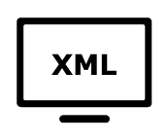
Information resources available on the VISS portal
Information system (IS) service catalogue is a state and private agency information service register in which the IS service descriptions usage conditions and calling address are included.
By using the services published in the catalogue it is possible to acquire information from the respective state institution information systems.
XML resource catalogue is the storage of all XML scheme, transformation, service and other resource descriptions. XML schemes are used to describe and standardise the information available on the IS.
In the classification catalogue, there are all VISS shared classifications that are granted version and multiple language support. The catalogue provides the possibility to use any previously created classifier in other systems as well thus saving resources allocated to developing and maintaining such solutions.
Notes:
Nav piezīmju.

Slide 7
Data exchange environment
Notes:
The data exchange environment is one of the basic functions of the integrator – it provides integration for all the state information systems.

Slide 8
What is the data exchange environment?
In order to be able to ensure the information exchange capabilities between the information systems of various institutions, solutions that ensure their integration have been created. They adhere to the following principles.
Unite access point to state information system data
Reliable and safe data exchange environment
Centralised data exchange solution
Standardised data access technical solution
Notes:
No notes.

Slide 9
How does data exchange work?
Service request
Request processing and turning to the
data source
Response data preparation and return of results
User
Data receivers
Data providers
VISS
Data receivers
Data providers
Data receivers
Request service
Intergration services
Business services
Data providers
Data receivers
Data providers
Data receivers
Data providers
Notes:
The schematic illustration of the data exchange solution using web services.

Slide 10
How is the data exchange organised?
Data provider
1. Decision (or adopting a law) to provide data
6. Gives permission and informs SRDA
2.An integration service and the respective business service is developed if such do not exist
3. Own hosting or at the VISS infrastructure and inclusion in the VISS IS service catalogue
Data exchange between data provider and data receiver is ensured
It is possible to connect several data receivers to such a service
SDRA
7. Provides access to the respective integration service data receiver based on the permission
Data receiver
4. Interested in certain data and finds out what data can be obtained from the institution in the IS service catalogue
5. Request permission from the data provider to use the integration service
Notes:
No notes.

Slide 11
At the moment, almost 200 data exchanges are active
TOP data providers
TOP data receivers
State Revenue Service
State Medical Commission for the Assessment of Health Condition and Working Ability
Register of Enterprises
State Social Insurance Agency
119 municipalities in Latvia
Riga City Council
Daugavpils City Council
State Social Insurance Agency
Notes:
Data of October, 2015.

Slide 12
Advantages of data exchange solutions
The broader public also benefits
To data providers
To data receivers
Centralised technological solution
Single network connection to VISS, single web service for many data receivers
Single network service for many data receivers
SRDA consultative support available
Safe data transfer channel with controlled access to data provider
Single connection to VISS, not with each data provider separately
Receives unmodified information online
Information integrates in it's information systems
Can be combined with various data provider services
Convenient following of the news in VISS IS catalogue in one place https://lvp.viss.gov.lv/VISS.ISSK
Auditing
Secure data transfer channel
Residents are not "document mailmen"
The companies may also be data receivers if the law provides for such access to any of the data provider's information
Notes:
Aditional infomation on advantages:
Inhabitants
the less clients need to be "document mailmen" - the law provides that the institutions shall perform direct data exchange without the involvement of a client as much as they can (Section 54, Paragraph six of the State Administration Structure Law and Regulation No.357 of 13 April 2010 "Procedures by which Institutions Provide Information in Electronic Form when Co-operating, as well as Ensure and Certify the Veracity of such Information");
Entrepreneurs
if the laws provide for using the data of an institution and the institution has created an appropriate network service in VISS, the entrepreneur can be the data receiver with the same advantages as state institutions or local governments. For example, SRDA data is received also by credit institutions.

Slide 13
Data distribution network
Notes:
There begins the slides about the second exchange type of bulk data exchange - DDN. This data exchange type can be used both in state institutions and local governments as well as businesses (an example – Latvenergo receives data from local governments in order to perform relief calculations (it can be read about here too http://www.vraa.gov.lv/lv/news/zinu_arhivs/article.php?id=38264)). 2 DDN presentations are sent by e-mail from which to take the information.

Slide 14
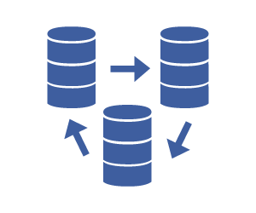
What is the data distribution network?
Data distribution and collection network facilitates the distribution of institution information system data and it's amendments both technically and administratively
Data distribution examples:
Data on electrical bills for calculating relief for local governments
Data of the Juvenile Persons Information System
About the Administration of the Maintenance Guarantee Fund
Data of the Rural Support Fund for local governments
Data for calculating Immovable Property Tax deductions for large families
Data distribution and receiving is possible through a WEB service as well as FTPS (both a FTP client as well as automatically)
Network is created based on the mailbox principle. At the workplace of an employee, it is easy to administer the list of data receivers and ensure the data delivery
The shared and received file structure XML schemes. It is possible to define a XML scheme for each data distribution or receiving channel according to the aim of sending/receiving
Notes:
DDN is a State Information System Integrator's shared component that can be used by state institutions, local governments and economic operators (for example – Latvenergo receives data from local governments to perform calculations for relief (more information:
http://www.vraa.gov.lv/lv/news/zinu_arhivs/article.php?id=38264).
Information exchange is performed using channels, each of which ensures the transfer of messages from one channel owner to several other members of a channel (DIK channel) or from several channel members to one channel owner (DSK channel).

Slide 15
DDN channel types
Type 1: one sender, several receivers
The messages on the DDN network are sent by a single sender that is the owner of the channel to several receivers that are participants of the channel
XML file_1
Data distribution network
Channel participants
XML file_2
XML file_3
Message sequence
Institution
e-mail inbox
Institution IS
Channel owner
Data distribution network 1
Institution
e-mail inbox
Institution IS
Institution IS
Institution e-mail inbox
Data distribution network 2
…
Institution
e-mail inbox
Institution IS
Data distribution network N
Institution
e-mail inbox
Institution IS
Senders
Receivers
Data flow
Notes:
No notes.

Slide 16
DDN channel types
Type 2: several senders, one receiver
The messages on the Data Collection Network (DCN) network are sent by several senders that are participants of the channel to one receiver that is the owner of the channel
XML file_1
Channel participants
Data distribution network
XML file_2
XML file_3
Institution IS
Institution
e-mail outbox
Message sequence
Data distribution channel 1
Channel owner
Institution IS
Institution
e-mail outbox
Data distribution channel 2
Institution
e-mail inbox
Institution IS
Institution IS
Institution
e-mail outbox
…
Data distribution channel N
Institution IS
Institution
e-mail outbox
Senders
Receiver
Data flow
Notes:
No notes.

Slide 17
Benefits from using the data distribution and collection networks
Data distribution standardisation
Sending and receiving large files
The institution can manage data receivers and distributors itself
With DDN XSL transformations, the data to be sent can be split according to the receiver
Notes:
No notes.

Slide 18
Document integration environment
Notes:
Not only does the document integration environment provide various benefits, its integration will be obligatory for state institutions.

Slide 19
What is the document integration environment?
The purpose of the document integration environment (DIE) is to ensure standardised, safe, provable and automated exchange of messages among the document management systems of state institutions. Already 53 institutions* have been registered in DIE so far.
DIE makes the exchange of such messages between institutions individually redundant and eases the tasks of officials performing document management.
Without DIE
With DIE
*2015.10.30 data
Notes:
The movement of documents without DIE is ensured by e-mail; however, the movement of documents with DIE is more convenient, safer and automated.

Slide 20
The future of e-governance:
paperless document movement
Current situation in electronical document circulation
2017
90%
2014
14%
(In 2013, in state administration altogether there were 5.7 million documents in circulation)
The future of e-governance:
Government action plan: 90% e-documents in 3 years
Introduction of an official e-address
Safe, guaranteed and efficient e-document movement
Notes:
No notes.

Slide 21
Institutions shall join DIE
To direct administration institutions without DIE:
DIE introduction shall be evaluated by foreign finance instruments
Shall be introduced
DIE
To direct administration institutions with DIE:
Shall ensure DIE usage
1 January
2016
1 May
2016
1 September
2017
To municipalities without DIE:
Invited to evaluate DIE introduction with foreign finance instruments
Invited to join DIE
Informative paper «On public administration document administration system integration environment action and comprehensive introduction into state administration»
Notes:
Obligatory joining in DIE for state institutions, recommended for local governments to be able to use all the benefits of DIE.

Slide 22
DIE participants
21 from101
connected to DIE
32 from 119
connected to DIE
Notes:
No notes.

Slide 23
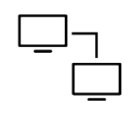
DIE establishment aim and advantages
Benefits
Safety
Automation
DIE
Convenience
Application to an institution
DIE
Speed
Institution
Objective
Unified standardised electronical document circulation environment
Private person
Notes:
With the help of DIE, it is possible to reach the aim – introducing a unified document circulation environment – as well as acquire various benefits (more information in the next slide).

Slide 24
Benefits of DIE
Safety
Automation
Ease of use
Ensures the protection of data of physical persons and the protection of documents during sending by ensuring additional encryption
Ensures the identification of the sender and receiver
Saving evidence on the fact of sending and receiving
Provides capability to automate the sent and received documents to speed up the document circulation and easing the work of clerks
Guarantees receiving of the document (no manual confirmation of receiving), including the undeniable fact of sending and receiving
Taking into account the fact that DIE is integrated using the electronic service «E-application to an institution» that is available on the Latvija.lv portal, the applications submitted through this service are available in the DIE of the institution
Notes:
Safety
Sender's and receiver's authentication
Document protection and safe transfer
Saving proof on the fact of sending and receiving
Traceability during the process of transportation
Automation
Guaranteed delivery
Document in the record keeping system "enters" automatically
Automatic document processing feature
Reduced repeated data input thus the number of mistakes
Higher data quality
Convenience
Unified data exchange format
Unified addressee catalogue
Speed
Reduced document circulation speed from 3 days to 3 seconds (sending speed is equivalent to that of e-mail sending
As well as savings on paper, office machinery and courrier expenses.

Slide 25
DIE for communication with private persons
Right now DIE ensures document circulation between state and local government institutions, but it is planned to introduce a new solution for communication with private persons:
Latvija.lv e-service «E-application to an institution» received documents will automatically transfered to state institutions DMS
SRDA infrastructure
State institutions
(without DMS integration with DIE)
Portal for communication
(IEW)
DIE
State institutions
(with DMS integration with DIE)
Application to an institution
Entities about whom there is no information in RE and PR (SRDA maintains a list)
E-address
! Using DIE it will be possible to send information to a private person (to the workplace of its client in Latvija.lv) from the DMS of the institution.
State registers:
Personal data
E-address data
Notes:
No notes.

Slide 26
Public Service Directory
Notes:
As it has been mentioned at the beginning of the presentation, on Latvija.lv there is a public service directory with more than 2200 descriptions of public services provided by state and local government institutions.

Slide 27
What is the Public Service Directory?
PSD is a register of public services provided by state administration and local government institutions, in which more than 2200 descriptions of public services and the methods of their provision are available.
For an institution:
1. User rights must be obtained
The entry of information in the PSD is carried out in VISS portal viss.gov.lv. An employee requires a user name and a password.
2. PSD description must be prepared
A single electronical form was developed for service description; this form can be used to enter, publish, edit, and delete information.
Useful materials:
A template of an application for obtaining the rights of a public service user
Methodological Guidelines on defining, describing and publishing public services provided by institutions in the Public Service Directory
Notes:
Everybody knows that state institutions provide many different services to both inhabitants and entrepreneurs. Institutions provide services according to the tasks and functions assigned thereto.
Since the number of institutions and services provided by them is great, in order for inhabitants and entrepreneurs to be able to orient in the assortment better, a single Public Service Depository has been created, providing an opportunity to find all the services provided by the state in a single place by different features:
- real life situation;
- institution’s affiliation;
- or simply by the name of the service in the search engine.
- The Public Service Directory or, as we tend to call it in our everyday life, “PSD” (pursuant to the provisions of the Cabinet of Ministers) must include information on all public services provided in the country.
For an institution to be able to add the description of a service in the PSD, two steps must be fulfilled:
obtaining user rights;
Preparing a PSD description.

Slide 28
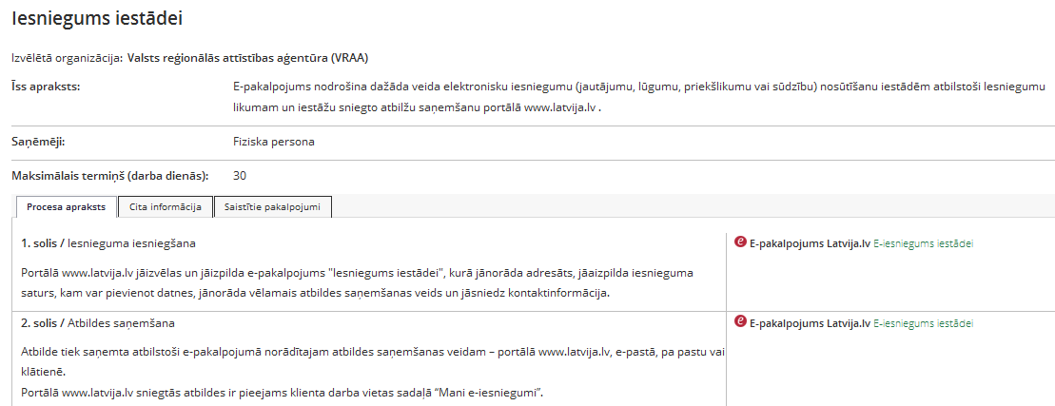
Example of a Public Service Publication card
Simple
and clear
information
Regularly updated
data (working hours, contact details etc.)
Notes:
Here, one example of public service catalogue card.
Simple and clear information.
Regularly updated information.
Cabinet Regulation «Procedures for the Exchange of Information in the Single Service Portal » defines the responsibility of state institutions to ensure accurate and current information on the single service portal Latvija.lv – the Ministry has included it into its methods, but it is not yet fully realised (the Law has not been adopted yet).

Slide 29
E-services environement for hosting and operating services
Notes:
The development of e-services is influenced by various aspects, for example, what the target audience (who is end user?) is, what difficulty level and electronisation level is planned and what the available resources are.

Slide 30
What are e-services?
E-services are a possibility to provide services remotely using information technology and communication means.
Viss.gov.lv
More than 350
e-services:
E-services for inhabitants
E-services for companies
Institution e-services
to other institutions
Example:
E-submission to an institution
Registration in Business Register maintained records
Located on VISS portal
in the e-services section, for example:
Data of State Social Insurance Agency,
State Land Service,
Business Register for institutions
SRDA infrastructure services
Notes:
In terms of target audience, e-services can be divided into three major groups:
E-service for inhabitants;
E-service for companies;
Interinstitutional e-service.

Slide 31
Service electronisation levels
On Latvija.lv and VISS there are
available e-services starting from
level 3
5.
Interinstitutional
e-process
without client involvement
4.
Completely electronic service (incl. payment processing)
3.
Client can electronically contact (client identification, blank and information submission electronically)
2.
Electronically accessible document samples for download
1.
Only available
information
Notes:
Furthermore, there are five e-service "electronisation levels":
1) Information about services is available on the Internet,
2) Blank and document sample download,
3) Electronic communication possible (electronic submission of client identification, blank and information),
4) Fully electronic service processing, including decision making, informing, payment processing,
5) Interinstitutional process without the involvement of the client - the data necessary for service provision is obtained without participation of a person by the institution itself.

Slide 32
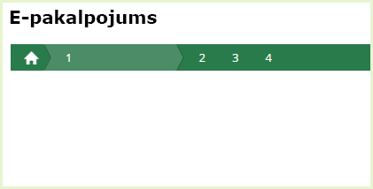
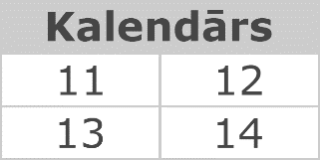
E-service functioning environment
– state portal latvija.lv
Client work space
E-service frame
Payment module
E-service
Interface elements:
Implementation steps
Radio buttons
Menus
Buttons
Calendar
Address search
Help elements
Notifications etc.
Single login (identified users)
SRDA
user support
Calendar
Button
E-signature application
Emulator, development examples and guideliness
Electronic document archive
Support application form and other elements…
Officials work place
Access to state information system and register data (services) using the VISS request service
Notes:
No notes.

Slide 33
The components of e-services
Single login
Unified platform
Latvija.lv
Normative reference register
E-service emulator for developers
E-service hosting and operating environment
Electronic document archive
Search engine
Clients work space
Document integration environment
E-service
Sending notifications
Address search component
Connection
to registers
etc.
Data distribution network
Payment module
Embedded control (card)
Notes:
From the point of view of the institution, Latvija.lv is a place for publishing e-services because everything for developing and publishing e-service integration solutions is available. Because of this, the institution does not have to make its own portal.

Slide 34
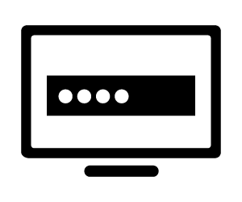
Single login module
Notes:
Unified application consist of two processes:
1) identification — determination of identity and its verification, i.e., authentication (a check, whether a person who logs in is actually the person he pretends to be);
2) authorisation — after successful authentication, the person accesses the information of concern or receives the right to carry out any activities.
This way a unified application module is useful for solutions to which only identified users are granted access.

Slide 35
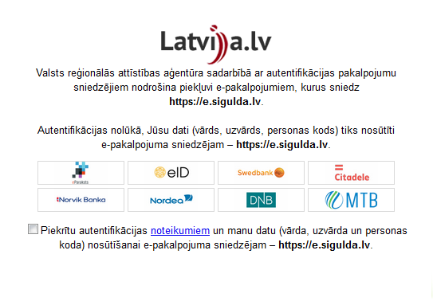
What is unified application?
Unified application ensures the possibility to authenticate on the portal using identification provider's (OCMA - e-ID card, LSRCT - e-signature, credit institution payment systems) authentication means.
Notes:
The institutions can choose which identification provider means are necessary. Commercial banks decide if they want to cooperate. The example depicts six possible Internet banks instead of seven (excluding SEB).

Slide 36
Number of authentications in 2015
Number of authentications via the single login module in 2015
1,338,252
1,062,112
273,257
19,609
24,762
Construction IS of the Ministry of Economics
Portal of the State Unified Computerised Land Register
Portal of the Road Traffic Safety Directorate
SRS Electronic Declaration System
Latvija.lv portal
More than 2.2 million times used in 2015 (+155% compared to year 2014)
Used in 26 portals:
Notes:
This slide shows five portals with the greatest number of authentications in 2015. Ever growing usage indicators is an affirmation – "the solution works".

Slide 37
The most active users of the single login module and their solutions
Joint catalogue of national museum collection
Digital culture map of Latvia
Culture
information
system
centre
Expert application system of the State Culture Capital Foundation
Project application system of the State Culture Capital Foundation
Electronic auction portal
Tiesas.lv
Portal of the State Unified Computerised Land Register
State
Regional
Development
Agency
Geolatvija.lv
Latvija.lv
VISS.gov.lv
Courts
Administration
Notes:
Available on 26 portals:
Portal of services provided by Carnikava County local government
Portal of the Road Traffic Safety Directorate
Construction IS of the Ministry of Economics
State Education Information System (VIIS)
Digital culture map of Latvia
Joint catalogue of national museum collection
Expert application system of the State Culture Capital Foundation
Project application system of the State Culture Capital Foundation
Portal of the National Archives
Portal of the Agricultural Data Centre
E-application system of the Rural Support Service
E-services provided by the RoL Patent Office
E-service catalogues of the OCMA Voter Register
Family card applications on the portal for families with many children
Portal of services provided by Sigulda County local government
Electronic auction portal
Tiesas.lv portal
Portal of the State Unified Computerised Land Register
SRS Electronic Declaration System
Krajobligacijas.lv portal
Geolatvija.lv portal
Latvija.lv portal
VISS.gov.lv portal
“Tulpe” portal of the State Environmental Service
SLS kadastrs.lv
Portal of the State Agency of Medicines

Slide 38
Advantages of single login
Convenient and secure authentication of users:
Latvija.lv;
On other portals of institutions.
There is no need to create new solutions and enter into cooperation agreements with other service providers.
There are two ways available:
With an eID card and e-signature;
Via the Internet banking system (currently 7 Internet banks available).
Single sign-on — one-time authentication allows you to authenticate on all portals with the integrated solution at the same time.
Notes:
Single sign-on – available for portals compatible with Latvija.lv that use the single sign-on module and that have the single sign-on functionality (exceptions apply). A list of such portals is available at the single sign-on window (in external systems).

Slide 39
New single login solutions are planned for 2016
Right now only private persons can authenticate; however, a procedure for authorizing private persons to represent legal persons will be implemented in 2016
Signatory persons
Authorised person
Heads of institutions
It is also planned to develop cross-border authentication
Notes:
In 2015, SRDA has successfully connected the Latvian eID card to the European Interoperability Framework STORK and the European Commission authentication solution ECAS. This marks the first step in implementing the cross border electronic identification regulation (eIDAS) till 2018, which will allow the citizens of Latvia to use eID cards to access e-services of public authorities in all of the EU.
RV VRAA piezīme:
Uzskatu, ka fiziskas personas identifikācija un pēc tam tās pārstāvniecības tiesību pārbaude Uzņēmumu reģistrā nav tas pats, kas juridiskas personas identifikācija. Proti, manuprāt, ir aplami teikt, ka mēs piedāvāsim juridiskas personas identifikāciju, jo identifikācijas līdzekļi ir fiziskām personām - juridiska persona (virtuāls apzīmējums) bez fiziskas personas nevar patvaļīgi identificēties šajā risinājumā.

Slide 40
Payment module
Notes:
Payment module is another VISS offered "template" which institutions can conveniently integrate on their service portals and in Latvija.lv services.

Slide 41
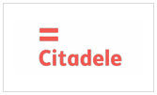
What is a payment module?
Maximally integrated tool for institutions which ensures service payment process and guarantees safe link with bank information systems as well as a convenient payment status.
Payment module
supports service payment process
Payment possibilities
Internet banking
Payment cards*
Usage possibilities
E-services
Public services
External portals
*from 2016
Notes:
A maximally integrated tool that guarantees safe connection with bank information systems as well as ensures convenient receipt of payment status.

Slide 42
Available payment services
Using Internet banking
With payment cards
Payments can be made with 7 banks
Starting from 2016 it will be possible to make payments with VISA and MasterCard
Implemetation planned
This solution allows to make payments using the payment cards of any credit institution that have been included in the payment systems.
Notes:
No notes.

Slide 43
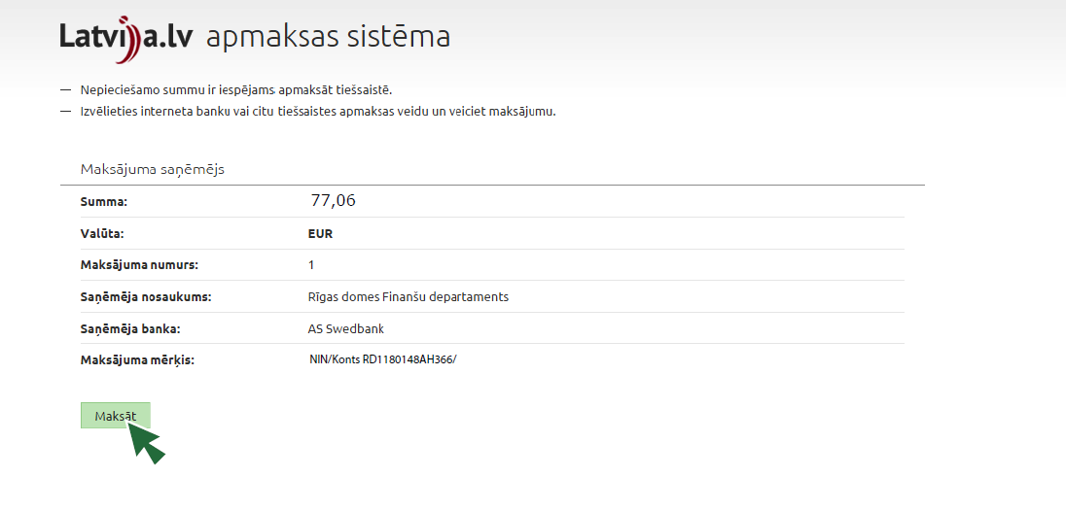
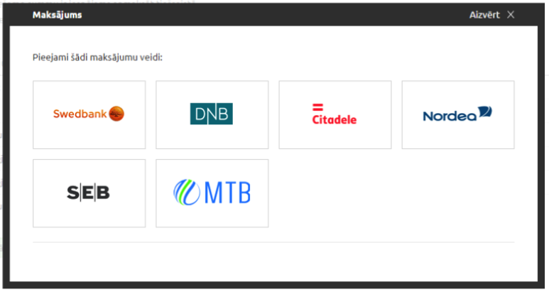
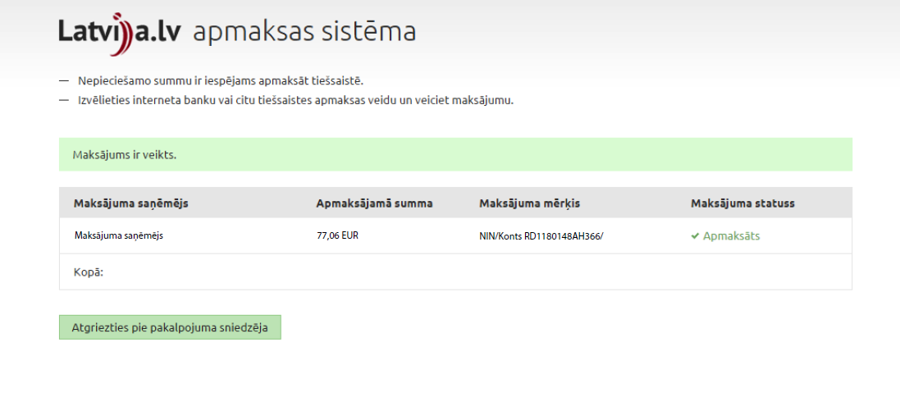
Example of the payment module
Notes:
Example of the payment module.

Slide 44
The payment module on 13 portals
Construction IS of the Ministry of Economics, bis.gov.lv
Latvian National Library Digital Library portal, digi.lndb.lv
E-service system of the Ministry of Agriculture, eps.zm.gov.lv
E-service portal of the Patent Office, eservices.lrpv.gov.lv
Geolatvija.lv portal, geolatvija.lv
Electronic auction portal (Court Administration), izsoles.ta.gov.lv
Portal of the National Archives, arhivi.gov.lv
SLS portal kadastrs.lv
Portal krajobligacijas.lv
Portal Latvija.lv
Joint catalogue of national museum collection, nmkk.lv
Business register portal, ur.gov.lv
Portal of the State Unified Computerised Land Register, zemesgramata.lv
Notes:
The payment module is already available on 13 portals.

Slide 45
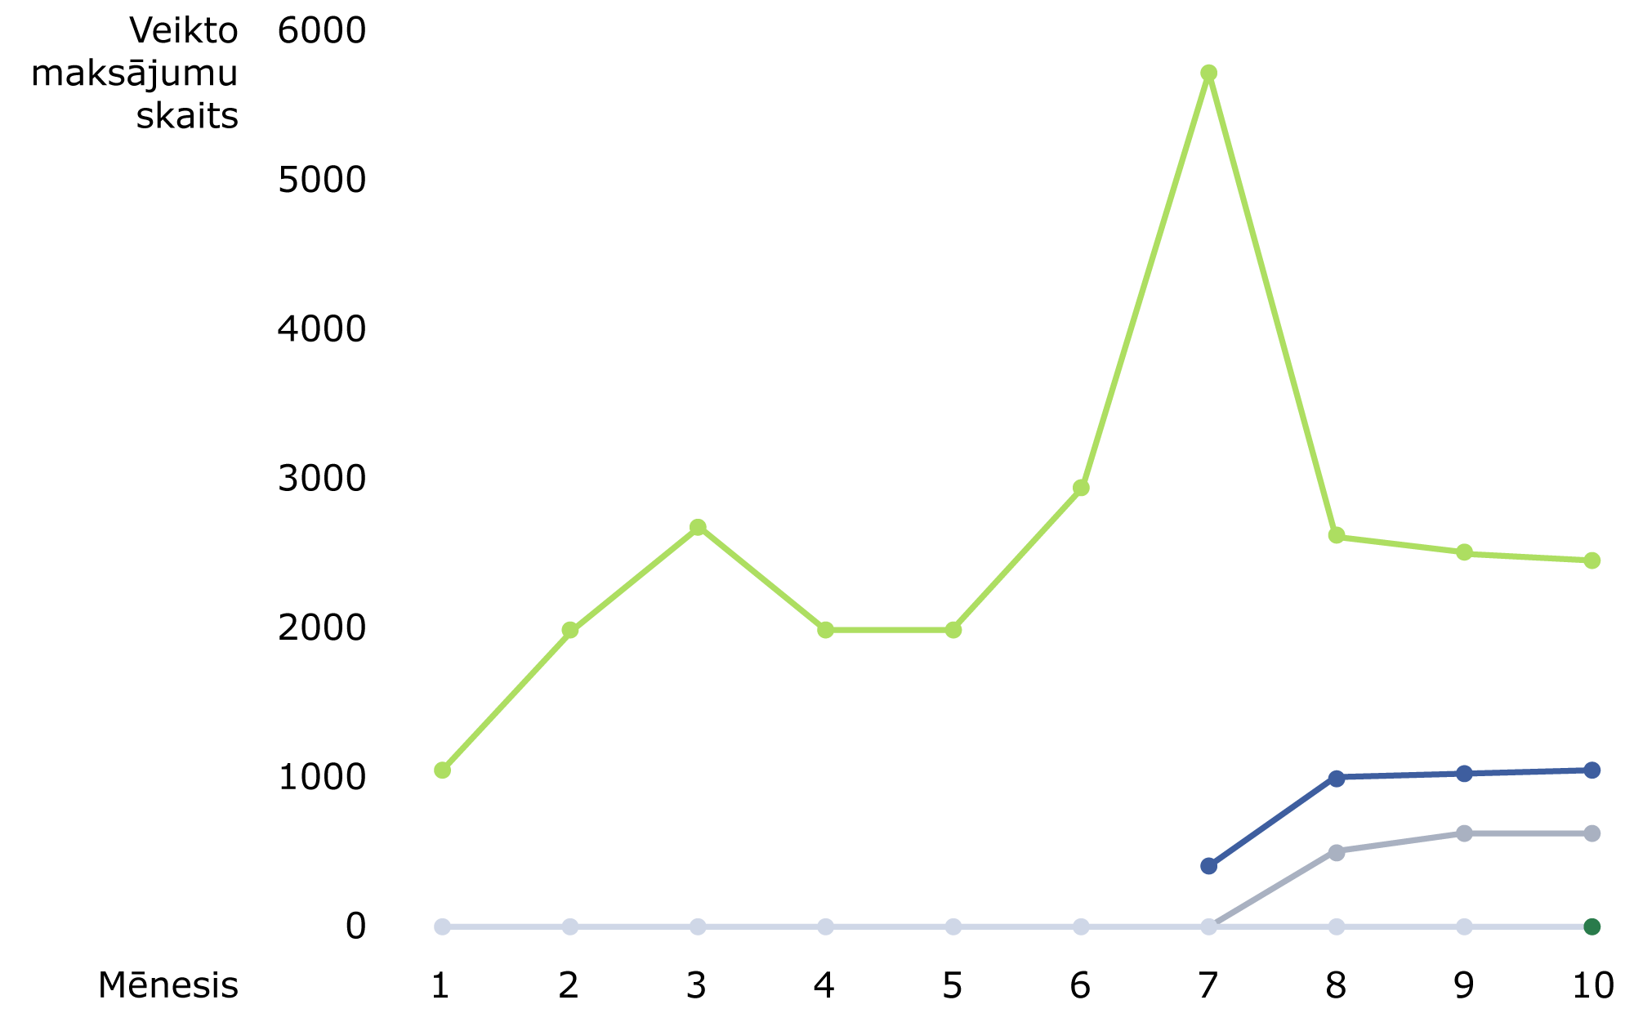
Payment module is used ever more often
Number of payments
More than 20 thousand processed payments in 2015 (+5 thousand compared to 2014)
Latvija.lv portal
SLS kadastrs.lv
Electronic auction portal
(Court Administration)
Month
Notes:
This slide contains statistics of the three portals in which the payment module is used the most.

Slide 46
Advantages of the payment module
No need for a separate payment system
Ensured cooperation with banks
Secure link to banking systems
Convenient payments on Latvija.lv or other portals
Client
Institution
Information on payment status
Notes:
No notes.

Slide 47
Geopolitical data integrator
Notes:
More information available at: https://viss.gov.lv/lv/GDS.

Slide 48
What is geospatial data integrator?
GDI is a centralised shared infrastructure for geospatial data collection and processing, it also ensures different institution geospatial data availability in standardised format to other institutions. The GDI consists of three parts:
Data and service module
Shared access management system
Catalogue of metadata
GDI is developed as a component of the VISS infrastructure and it is a part of the e-service infrastructure that uses the existing VISS components and standards in its operation.
The system provides access to geospatial data and map products (in the form of web services) which have been developed by data holders in Latvia, for example:
Latvian Geospatial Information Agency,
State Land Service.
GDI users are modern geospatial data processing systems, incl. TAPIS.
Notes:
A system provides access for users to geospatial data and map products which have been developed by data holders in Latvia, for example Latvian Geospatial Information Agency and State Land Service. GDI users are modern geospatial data processing systems, for example TAPIS.
The GDI consists of three parts:
1. Data and service module – the part that is not visible to users. The infrastructure is based on the ArcGis solution. A database stores geospatial data and the geospatial services are created with the ArcGis software (various types – WMS, WFS, REST, Inspire services). All data exchange is based on services and no direct connection to the databases for extracting data is made.
2. Shared access management system (SAMS) – this solution is hosted on the VISS portal and is available to all users. It allows the holder of the geospatial service to protect the service by imposing various limitations, for example, allowing access to users of a particular institution and in a specific scale.
3. Catalogue of metadata – here the holders of the data can describe their data and their services. It is also possible to view the data that have not been digitised, in order to inform the public that such geospatial data exists.

Slide 49
Find out more:
State and municipality service portal www.latvija.lv
State information system integrator www.viss.gov.lv
VISS documentation section https://viss.gov.lv/lv/Informacijai/Dokumentacija
Notes:
More information is available on these websites…

Slide 50
Contact information
For communication with State Regional Development Agency
E-service development department specialists:
e-mail: epak@vraa.gov.lv
Notes:
...if you want to cooperate or have further questions, please contact the SRDA specialists of the E-service development department specialists by using the indicated contact information.

Slide 51
State Regional Development Agency services for state and local government institutions
What is State Information System Integrator?
Notes:
Thank you! Any questions?

